Slide 1
Photonic measurement of gas pressure.
Arbeitsgruppe 7.55
André Kussicke

Slide 2
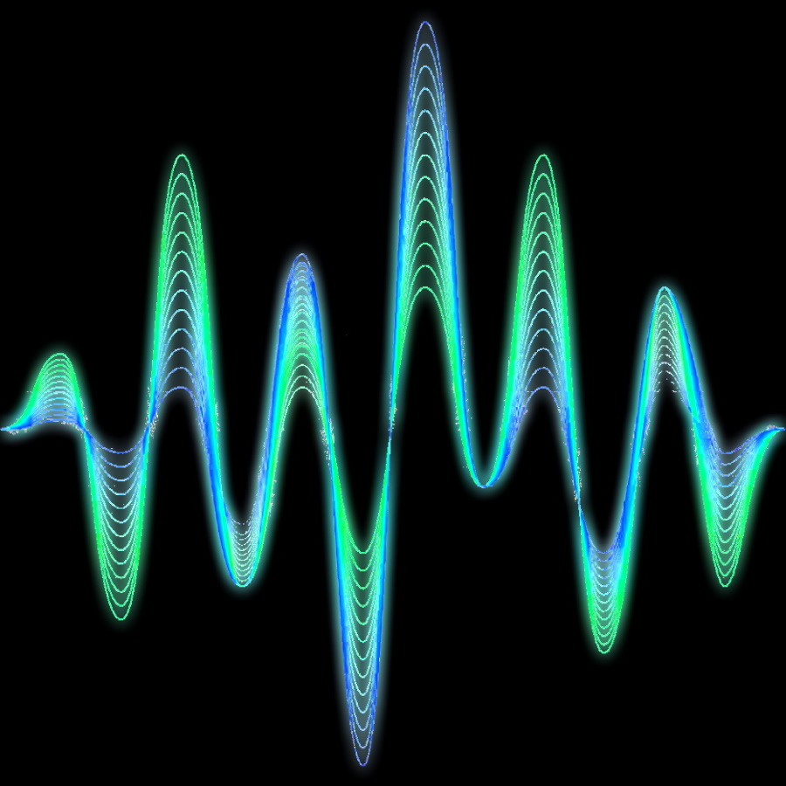
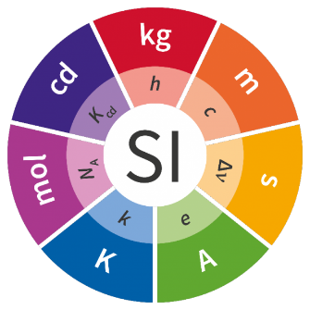
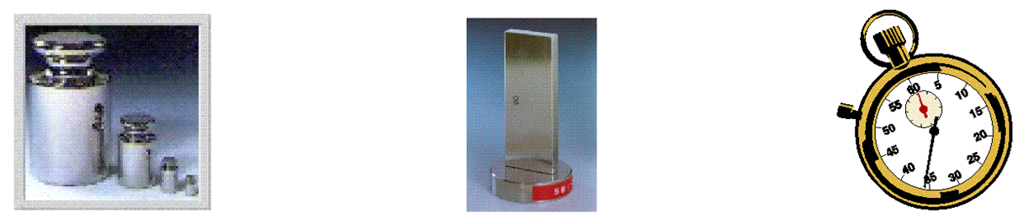

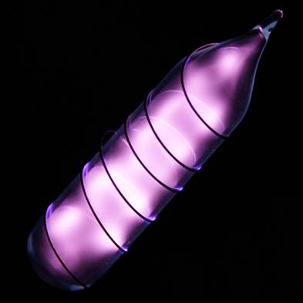
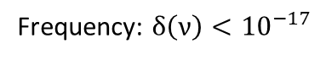
Motivation of the „QuantumPascal“ Project
Usefull in vacuum
Frequency: $δ\left(ν\right)<{10}^{−17}$
New SI: u(k) = 0
Status Quo:
Force per area
Methods based on density measurements
Helium
New theory
u(n_{He}−1) < 10⁻⁶
kg
m
s
K
m
s

Slide 3
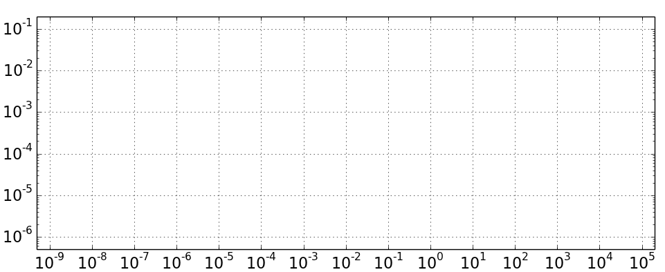
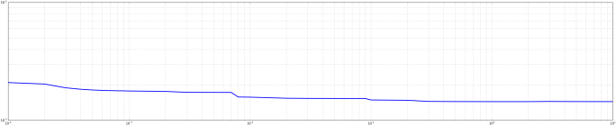
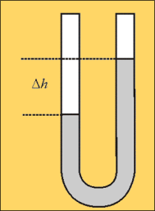
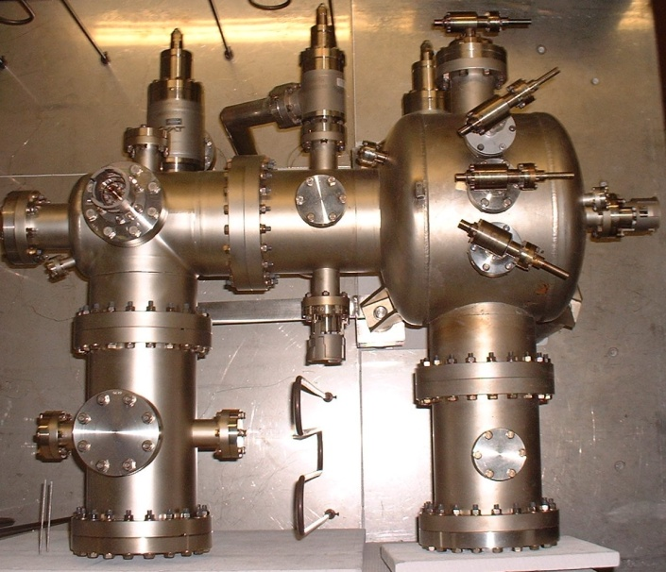
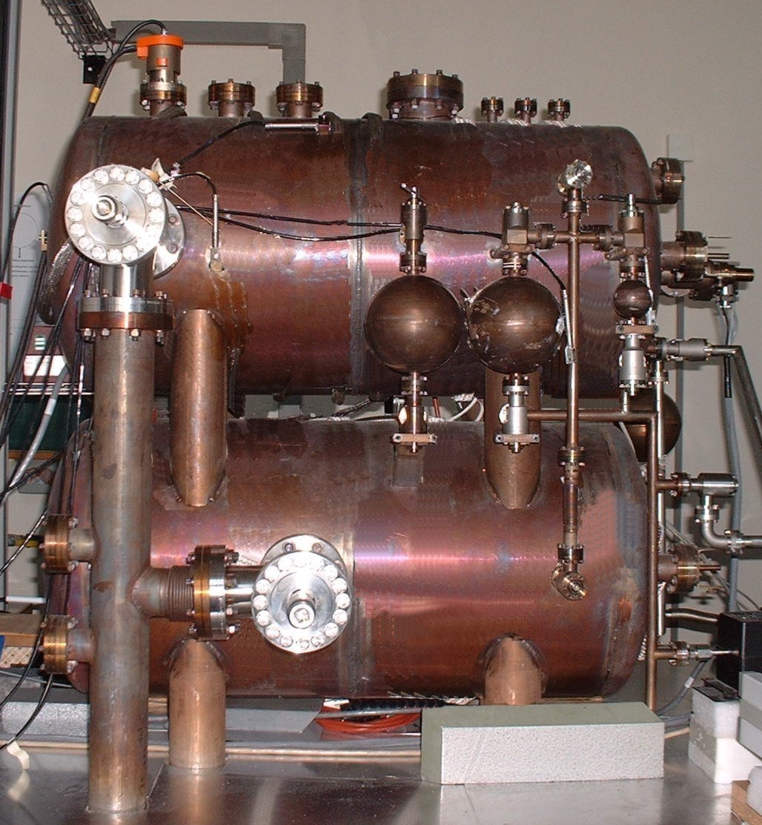
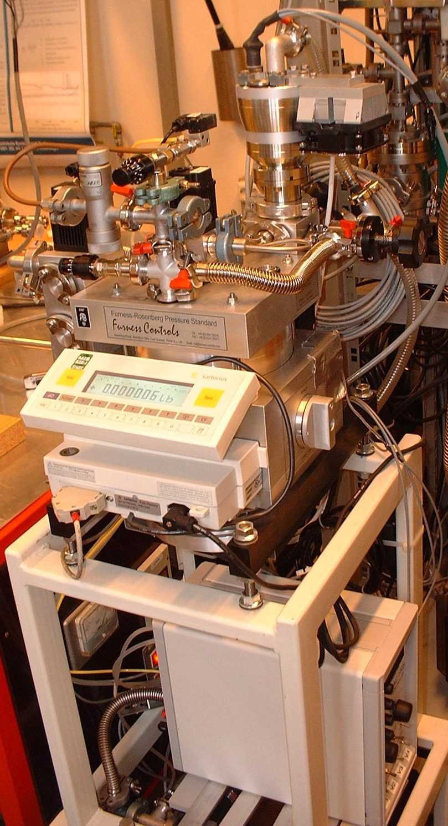
Quantum Pascal Project: Goals
Status Quo – Established methods
AG 7.54 – Vacuum Metrology
AG 3.33
Hg-Manometer
Schwien (BS)
Continious Expansion
Static Expansion
Relative uncertainties
Pressure-
gauge
Pressure (Pa)
Design new optical pressure standards.

Slide 4
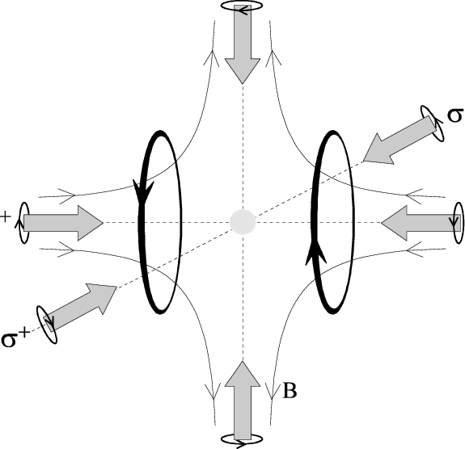
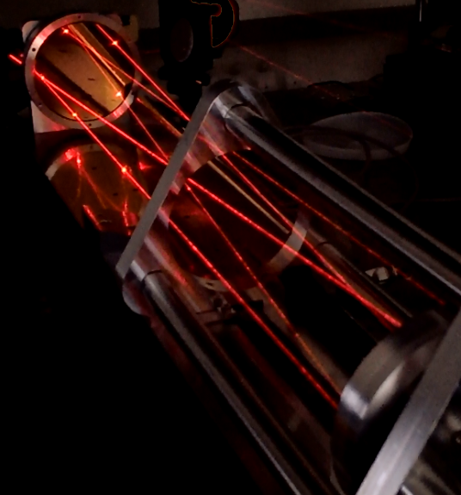
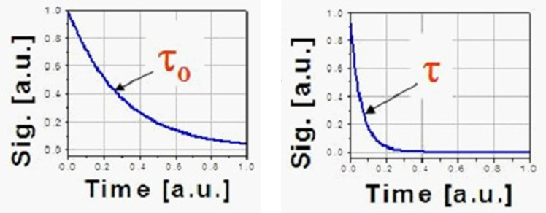
New photonic methods
AG 7.54 – Vacuum Metrology
AG 3.33
Continious Expansion
Static Expansion
Pressure balance
relative uncertainties
Hg-Manometer
Schwien (BS)
Magneto-
optic
traps
Absorption-spectroscopy
with Herriott-Cells (CO₂)
Cavity-Ring-Down-
Spectroscopy (CO₂)
Refractivity measurements
(He, Ar & N₂)
Pressure (Pa)

Slide 5
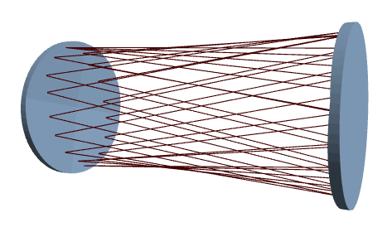
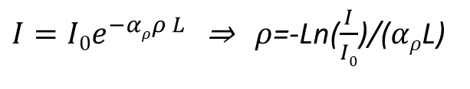
Measurement principle
$I=I0e^{−αρρ L }$ ⇒ $ρ$=-Ln($\frac{I}{I0}$)/($αρ$L)

Slide 6
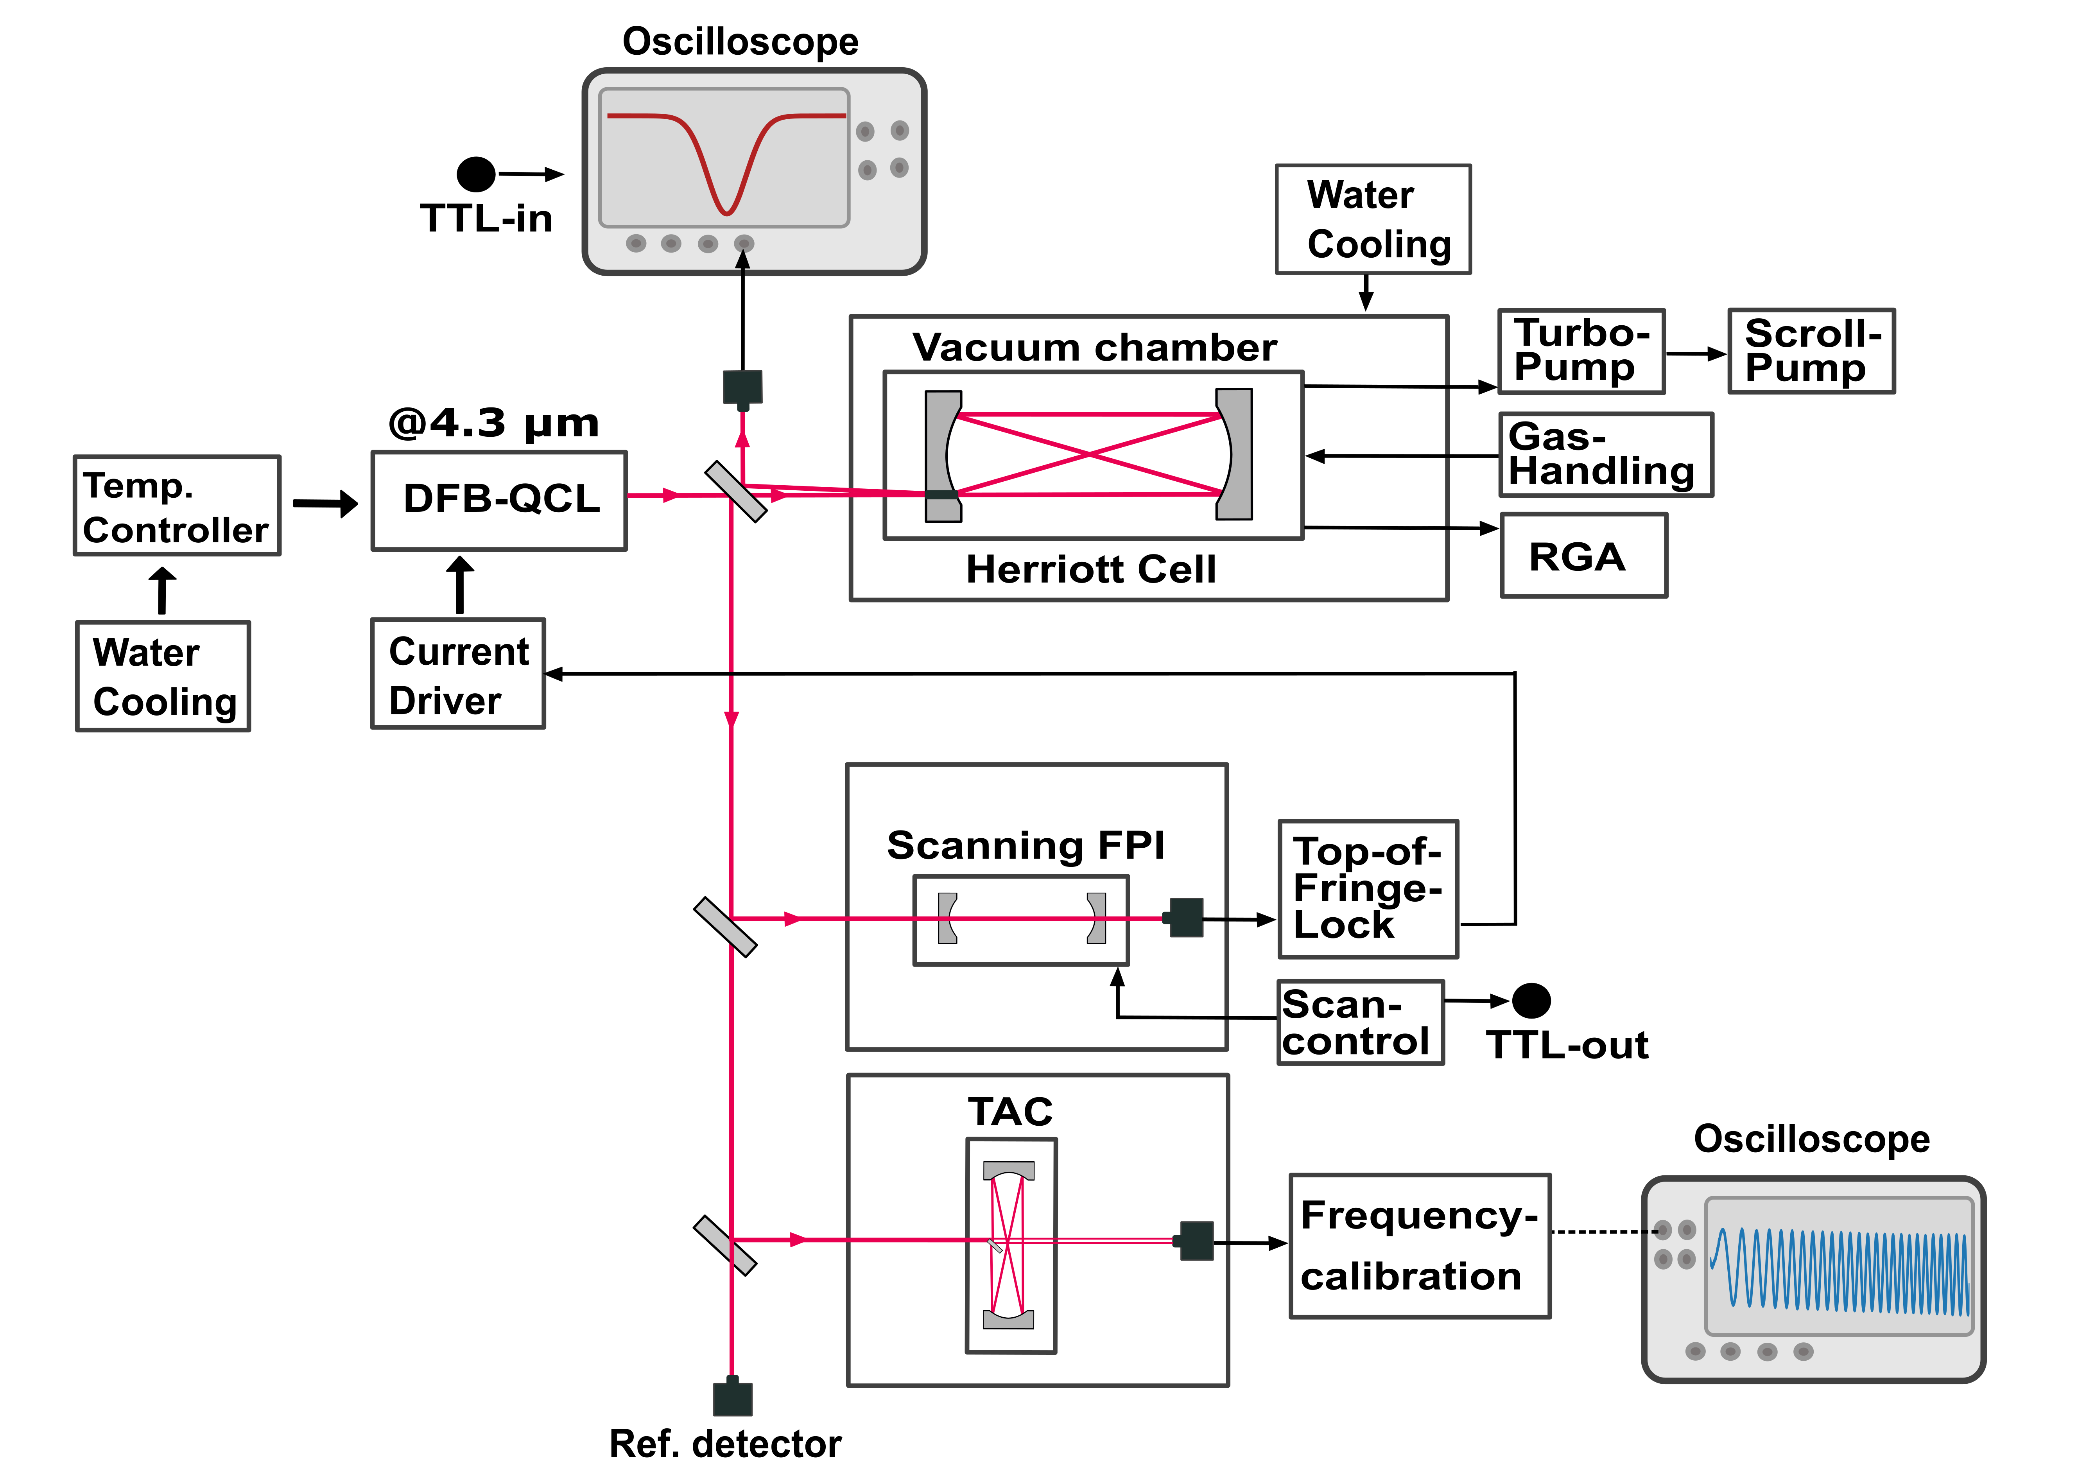
Experimental setup: TDLAS
2
1
3

Slide 7
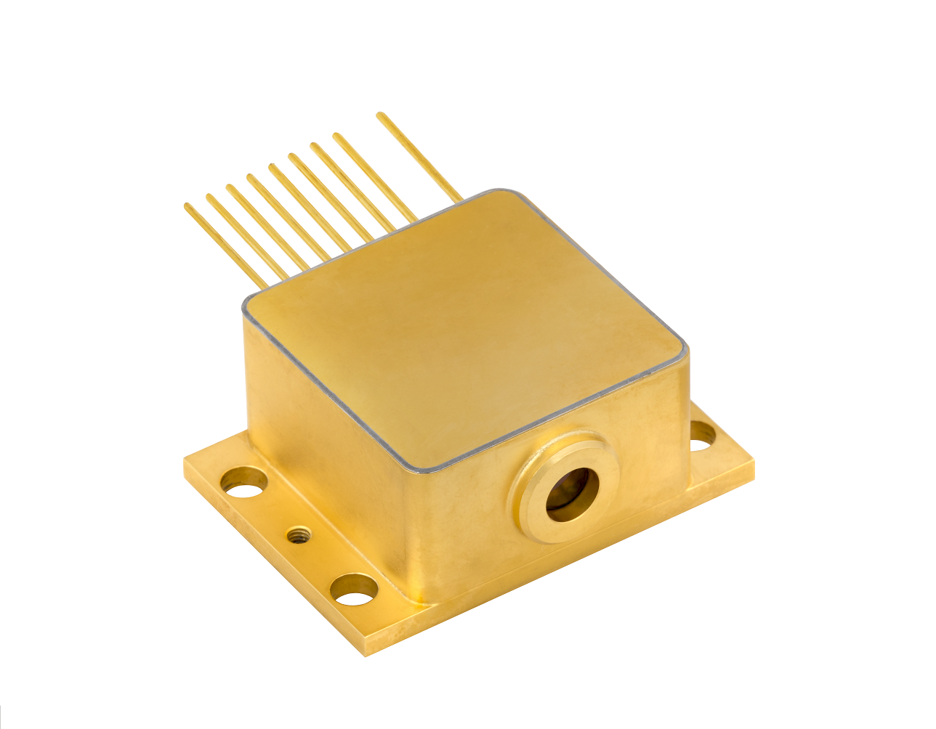
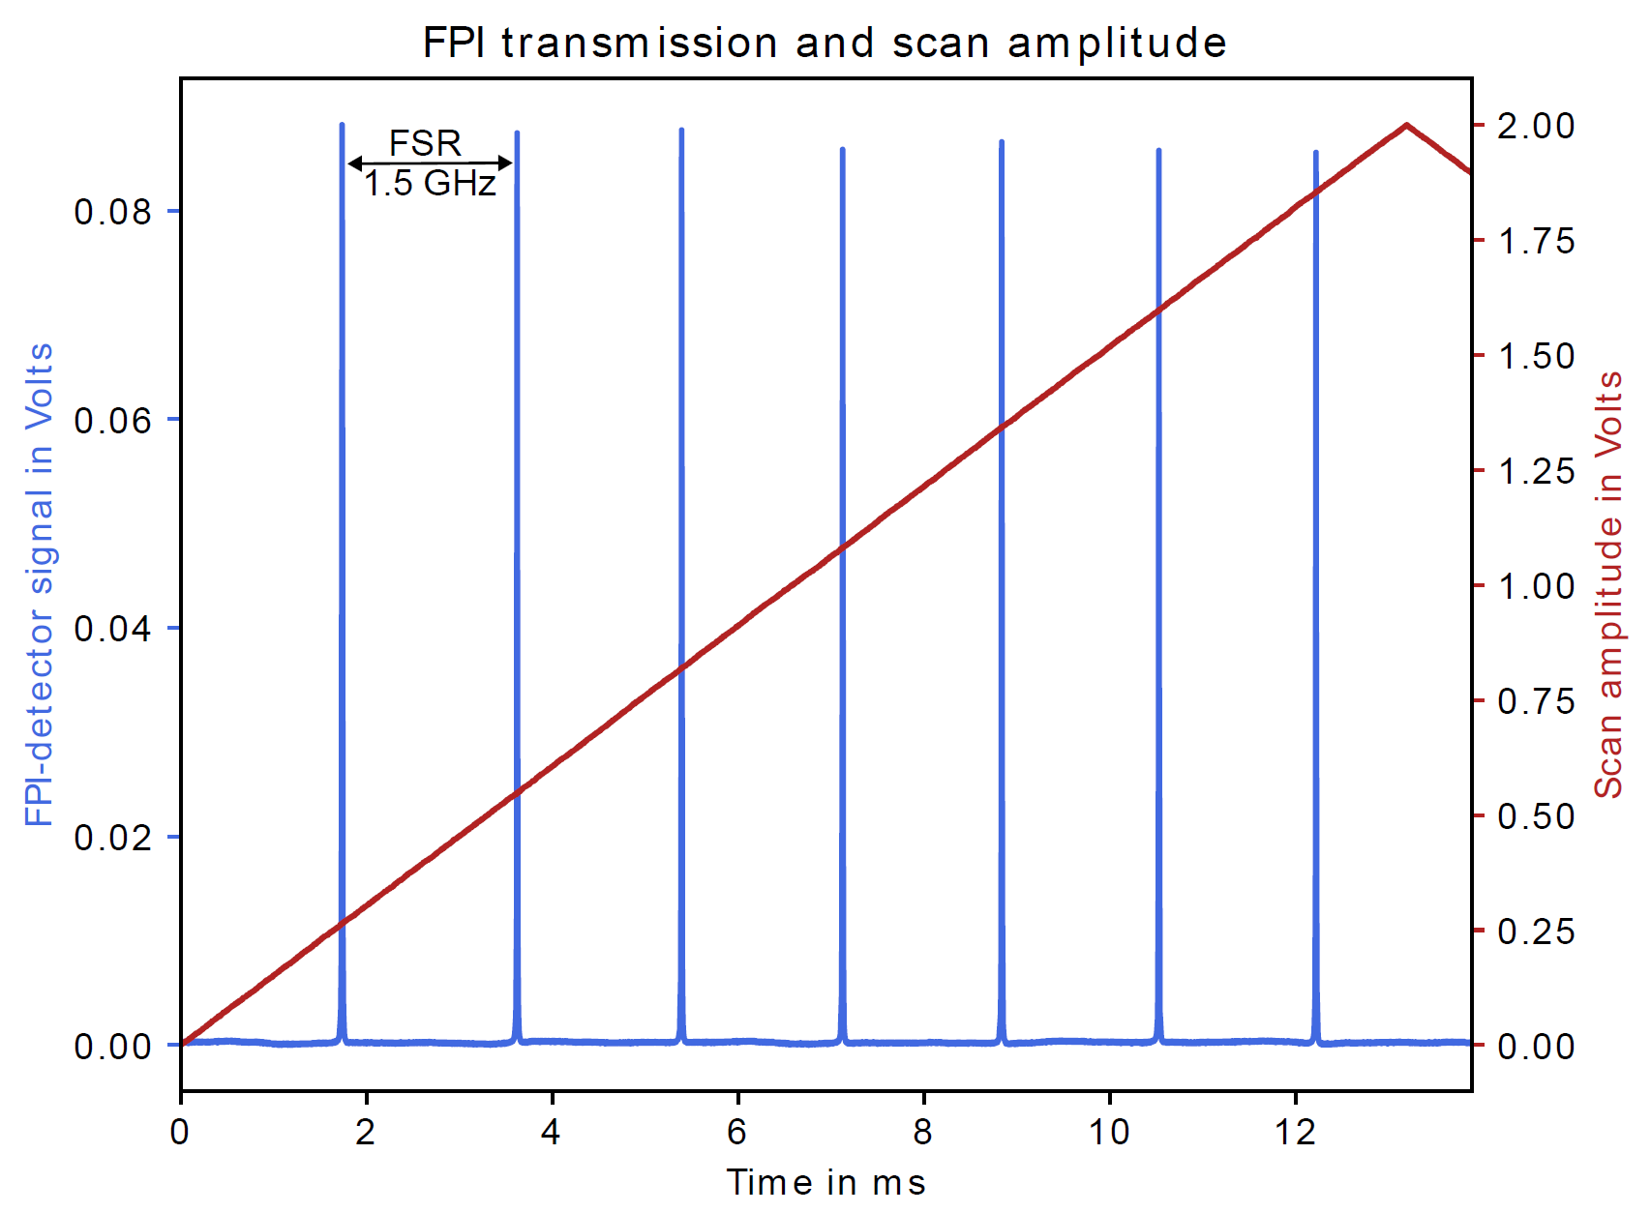
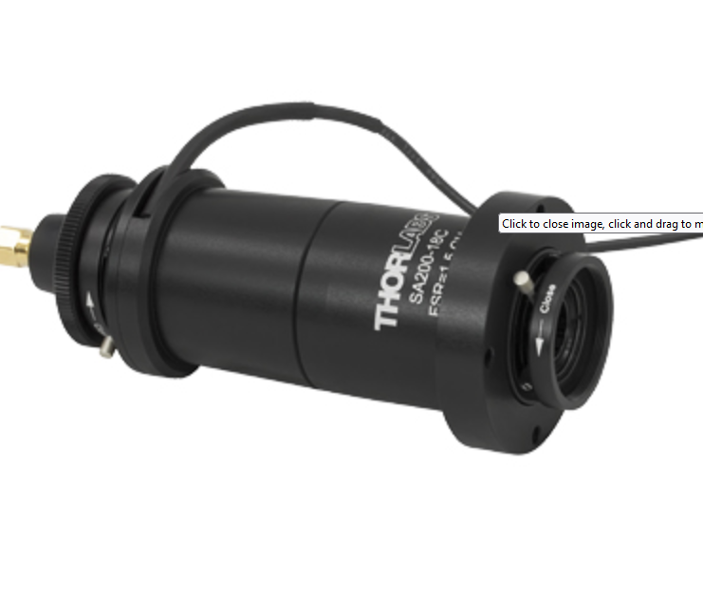
Determining the emission frequency
Quantum Cascade Laser
Scanning FPI for 4-5 µm.

Slide 8
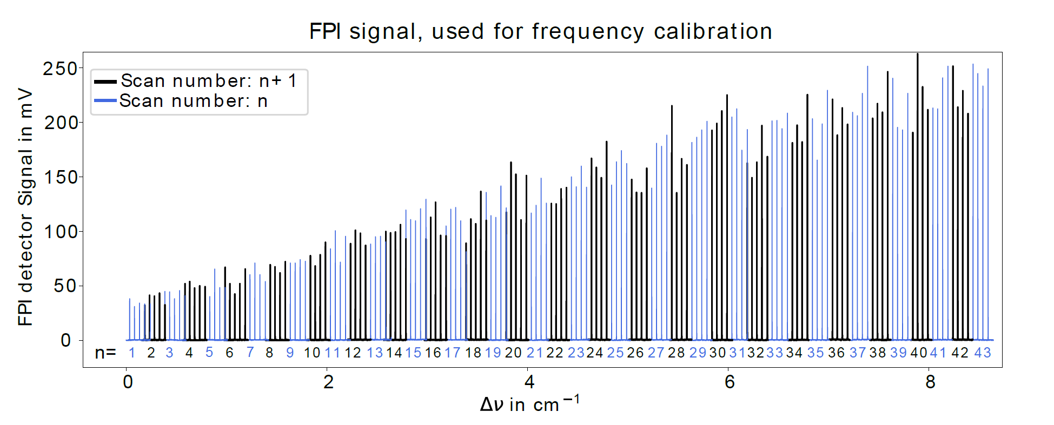
Determining the emission frequency
QCL emission frequecy is step-wise increased by adjusting the operating temperature
Increase in: 1°C steps from -20 to +23°
Total scanning range of 0.263 THz or 8.8 cm⁻¹

Slide 9
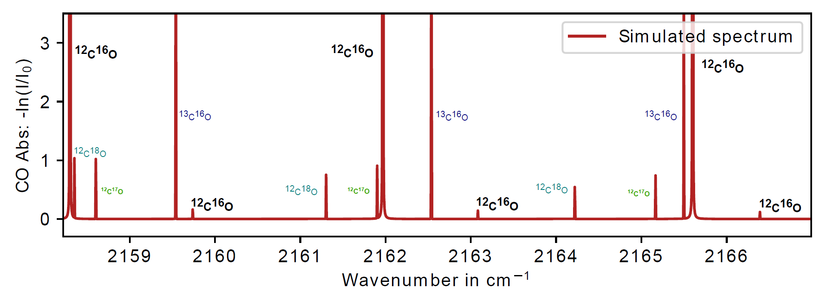
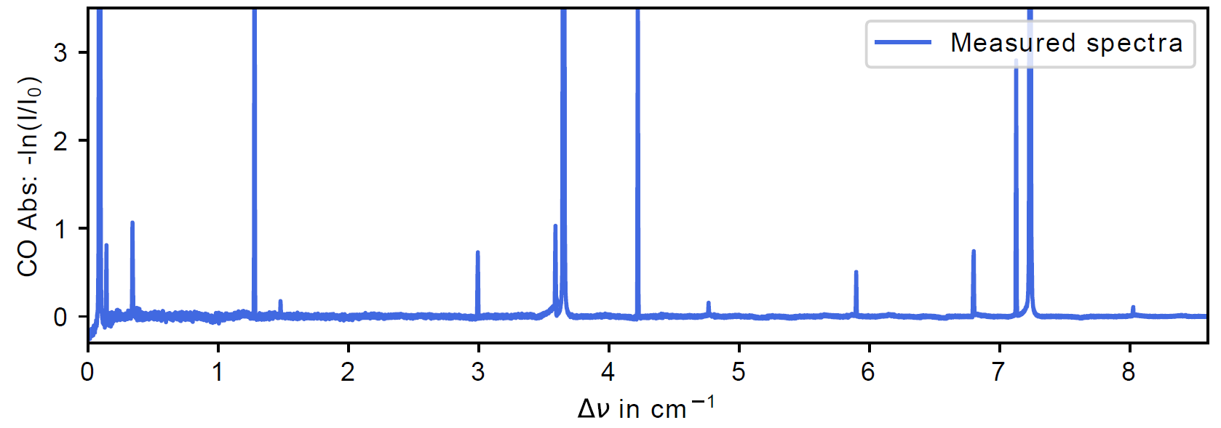
Absolute QCL emission frequency

Slide 10
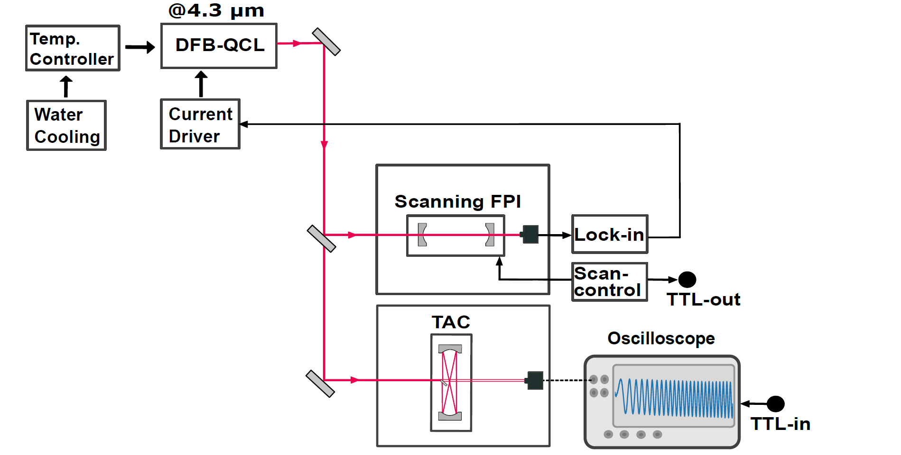
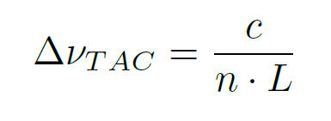
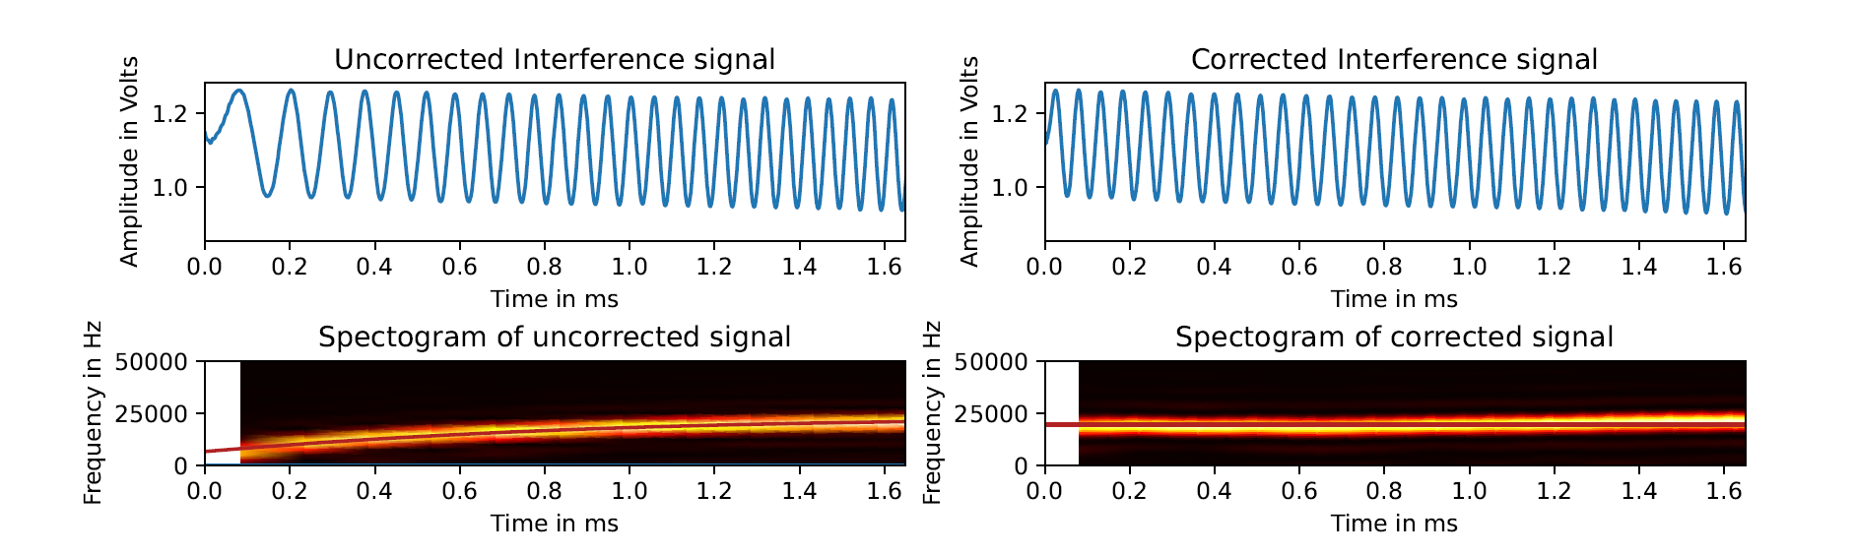
Frequency calibration

Slide 11
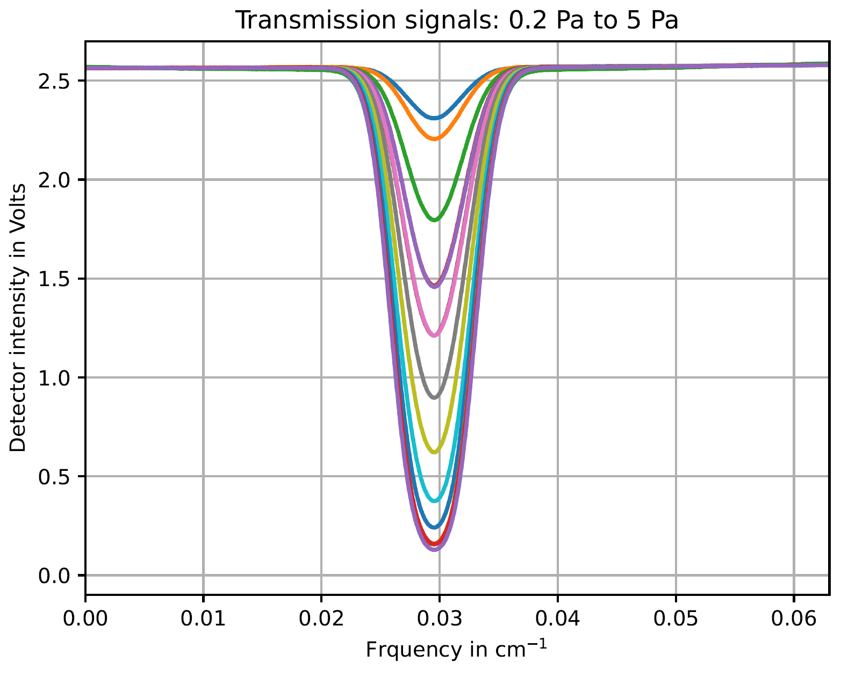
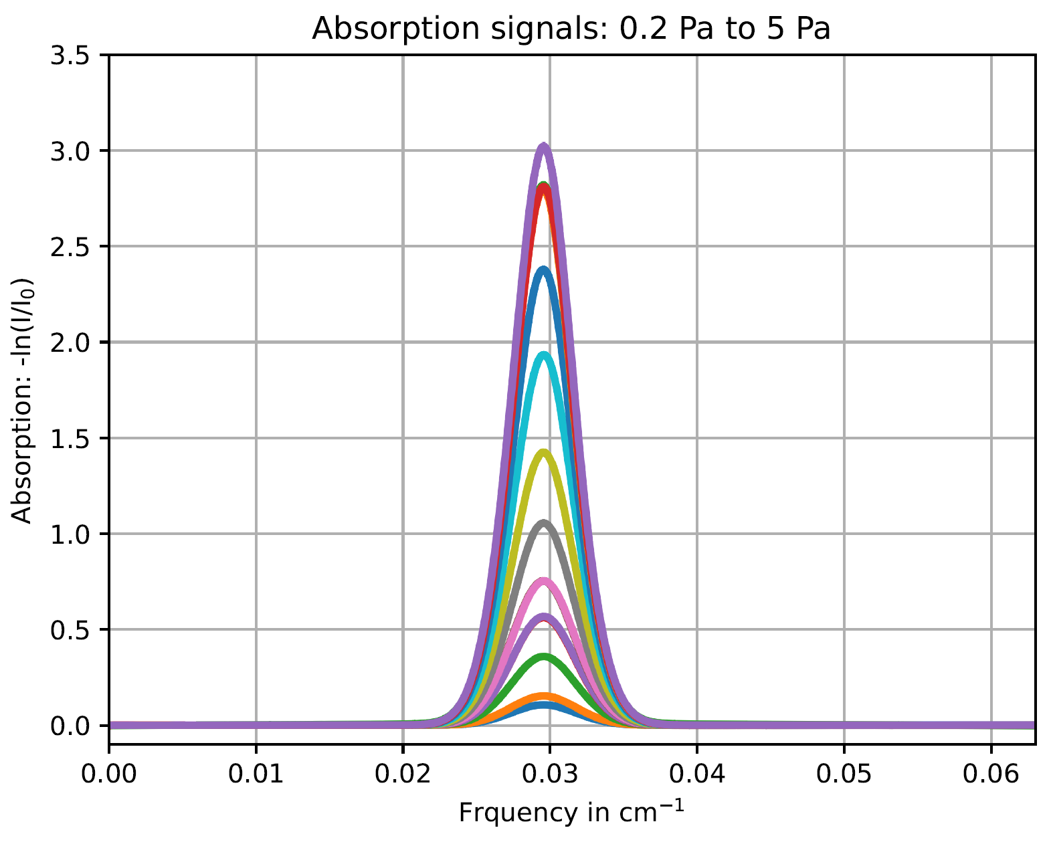
Pressure dependent CO-measurement

Slide 12
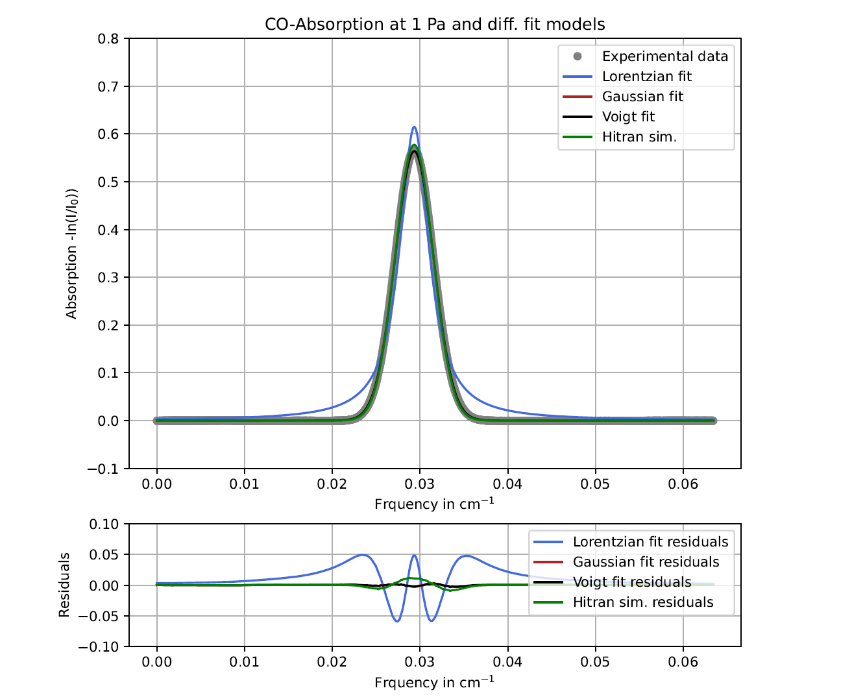
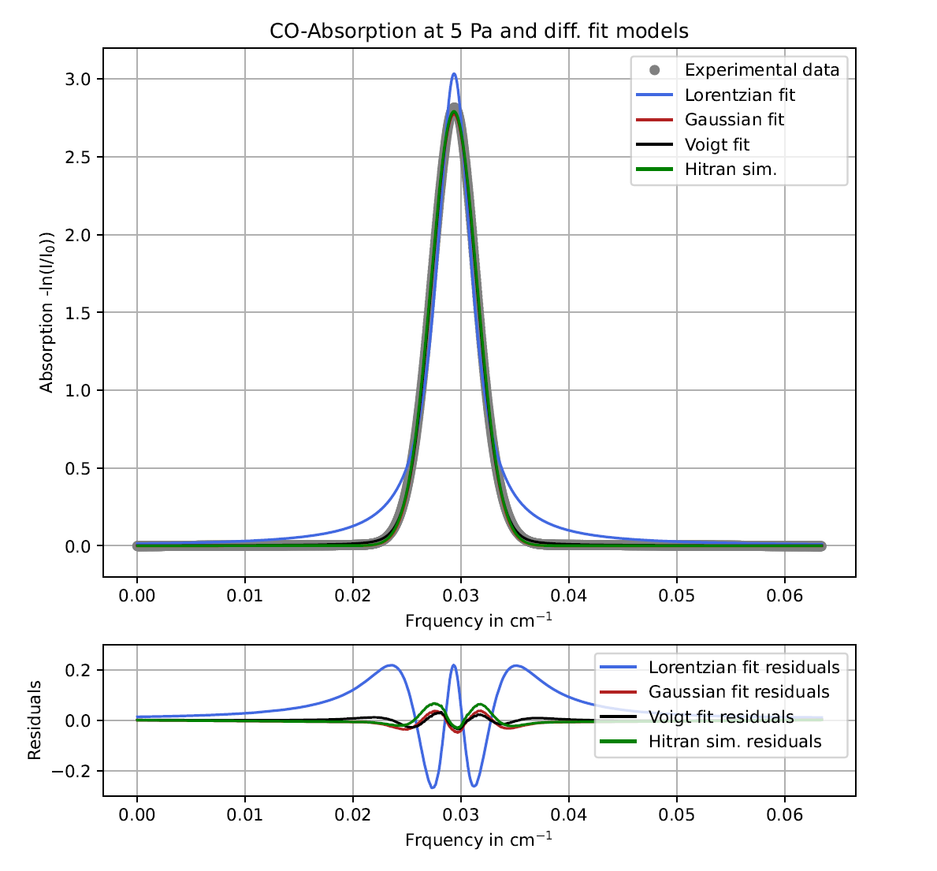
Data fitting and integration

Slide 13
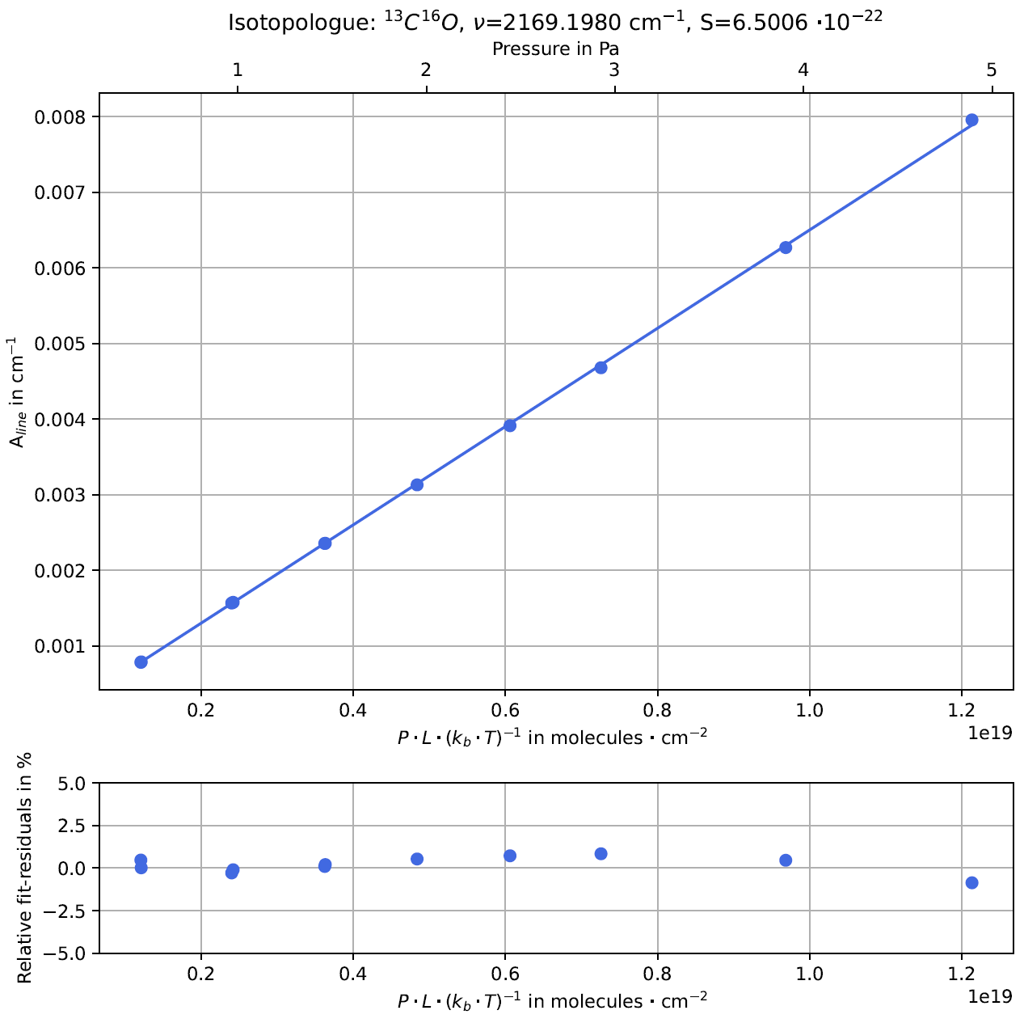
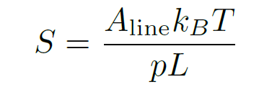
TDLAS results: Absorption line strength

Slide 14
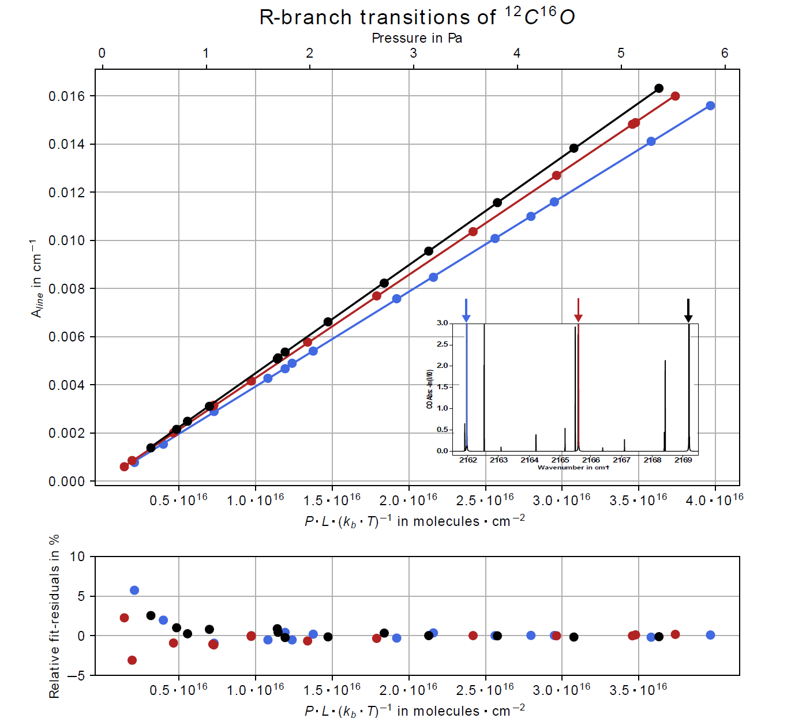

Slide 15
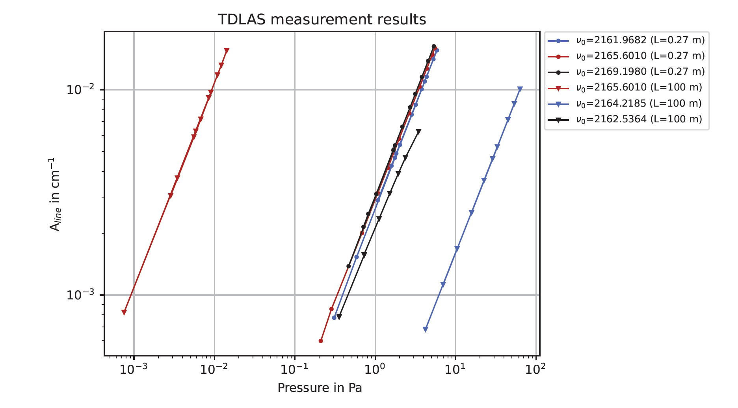
TDLAS as a pressure standard

Slide 16
Physikalisch-Technische Bundesanstalt
Braunschweig und Berlin
Abbe Straße 2-12
10587 Berlin
André Kussicke
E-Mail: Andre.Kussicke@PTB.de
www.ptb.de

